Slide 1
Solar energy prediction using machine learning

Slide 2
Team information
Name | Id
Shrinivas Gollalappa Kadaganchi | 700750193
Vamsi inampudi | 700747651
Chaitanya Phani Kumar Akula | 700740502

Slide 3
Team contribution
Name | Responsibilities
Vamsi Inampudi | Visualizing the data patterns using matplotlib and seaborn, analyzing the data using graphs worked for final report preparation along with teammates.
Chaitanya Phani Kumar Akula | Loading the dataset to feed the model. Data preprocessing, checking correlation,since the dataset contains a categorical data used the label encoding techniques for training the model.
Shrinivas Gollalappa Kadaganchi | Implemented different machine learning models on the dataset to get the desired outcome and pick the best model to predict generated and exported energy.

Slide 4
Motivation
The motivation for this idea derives from the growing use of renewable energy plants, such as solar power plants.With the increased use of power plant setup, there is a great need to create cost-effective setups. To design a cost effective set up knowing output or generated and exported energy is important. Existing systems failed to capture the data complexity. Therefore building an effective machine learning model to understand and predict the real time data is important.

Slide 5
Objectives
Constructing machine learning models to predict the generated and exported energy using weather parameters and derived features of energy at a particular Photovoltaic power plant.
Observing the variability in the data and taking measures to reduce the variability.
Applying various ensemble models like bagging regression models, boosting regression models and stacking regression models to reduce the variability of the data and to improve the efficiency of the predictions.
Comparing the performance of the bagging, boosting and stacking ensemble models.
Analyzing the best fit line of predictions of the models using scatter plot, feature importance plot and permutation importance test.

Slide 6
Related work
Academic study has increasingly centred on examining the dynamics of solar energy prediction.In this section we review the related works on solar generated energy and exported energy using machine learning.
Support Vector Machines Based on Multi-source Data Fusion:
This paper proposes the SVM-DF(Support Vector Machine) model and ANN(Artificial Neural Network) models to predict the solar power generated and solar power emission. SVM-DF is an extension of general SVM. To perform experiments weather parameters and power related data are used. To improve the performance another set of weather data NWP is used. In the experimental analysis SVM-DF outperformed the ANN regressor [1].

Slide 7
Related work
Solar Power Generation Prediction from Weather Forecasts using Machine Learning:
This paper proposes a strategy in building the smart power grids. Optimisation of the number of grids in the solar energy system is gaining popularity. To assist this information of weather data and geographical location is needed. Weather data is collected from NSRDB( National Solar Radiation Database). Multiple linear regression models like Ridge and Lasso are implemented to forecast the solar energy [2].
Solar Energy Prediction using Meteorological Variables:
This study presents a time series solar energy forecasting model for 7 days in advance. To predict the solar energy two types of parameters are considered one is plant related parameters and temperatures parameters. In the first category inverter, cables are considered and in the second category statistical parameters of the ambient temperature are considered. Experimental results showed accurate results except on overcast days [3].

Slide 8
Problem Statement
World is largely dependent on fossil fuels but these resources are finite.Leaving the era of fossil fuels behind is gaining enormous pace. Solar energy is the cheapest way to produce electricity without using fossil fuels in light of the rising greenhouse effect.Solar photovoltaic is gaining popularity for its modularity and low cost.By the end of 2020, there were 710 GW of solar PV installations worldwide.
Many nations are entering the markets for selecting the most affordable electric equipment. We need to be aware of the device power forecast in order to accomplish this.Predicting the solar energy(exported and generated) is a challenging task due to high variance in data.

Slide 9
Proposed solution
In this project we are proposing ensemble regression models to predict both generated energy and exported energy.
Main objectives of the project are:
Selecting the 2 individual datasets for experimental analysis.
Analysing the data with Exploratory data analysis
Building multiple regression models to predict the solar energy generation and exported energy using weather and plant parameters.
Evaluating the models and conducting a comparative analysis of the models

Slide 10
Results summary
 | R2 | RMSE | MSE | MAE | MAPE
Stacked ensemble regressor | 0.99 | 0.15 | 0.02 | 0.12 | 0.17
Bagging regressor | 0.99 | 0.42 | 0.18 | 0.25 | 0.16
Gradient boosting regressor | 0.97 | 0.94 | 0.899 | 0.69 | 0.03
Table.1. Summary of model performances

Slide 11
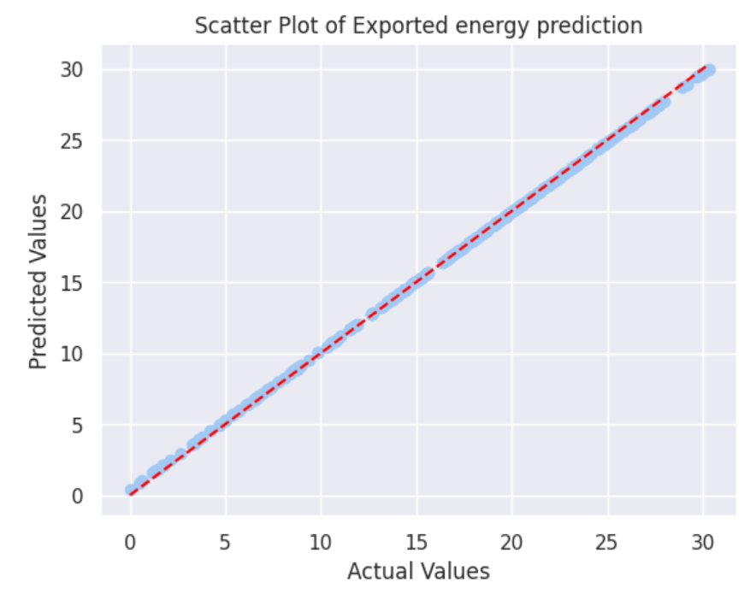
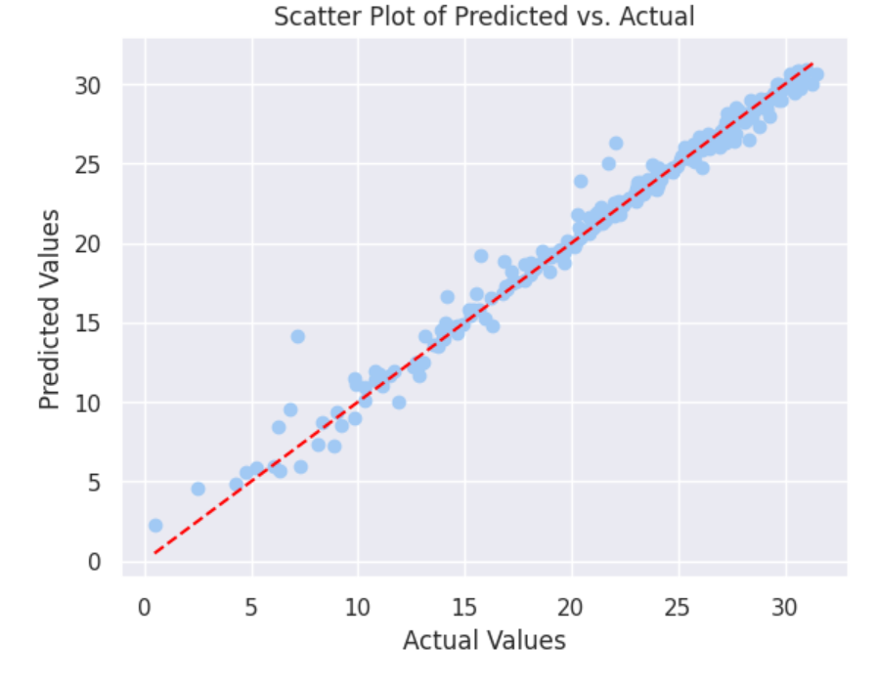
Scatter plot of exported vs generated energy
fig.1.Generated energy predictions
fig.2.Exported energy predictions

Slide 12
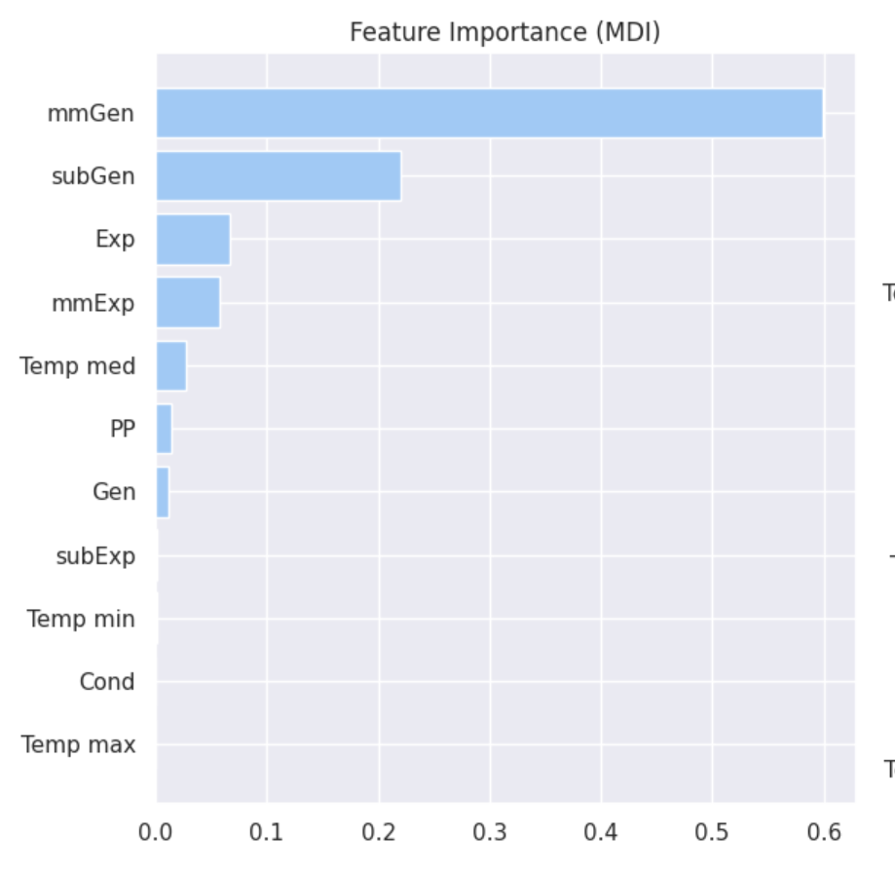
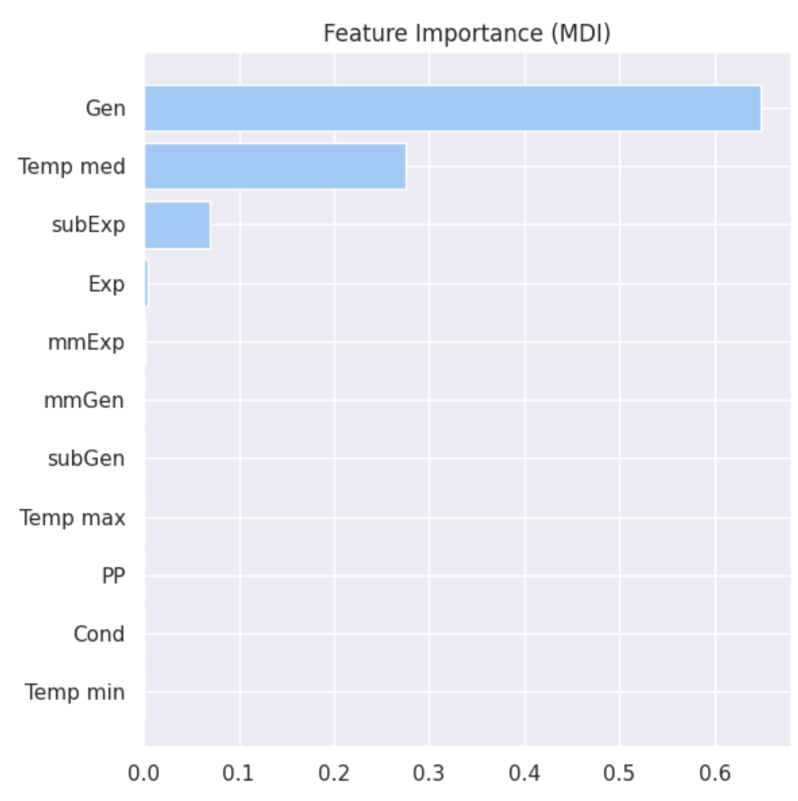
Feature importance exported vs generated energy
fig.3.Feature importance for generated energy prediction
fig.4.Feature importance for exported energy prediction

Slide 13
References
[1].W. Buwei, C. Jianfeng, W. Bo and F. Shuanglei, "A Solar Power Prediction Using Support Vector Machines Based on Multi-source Data Fusion," 2018 International Conference on Power System Technology (POWERCON), Guangzhou, China, 2018, pp. 4573-4577, doi: 10.1109/POWERCON.2018.8601672.
[2].R. Singhal, P. Singhal and S. Gupta, "Solar-Cast: Solar Power Generation Prediction from Weather Forecasts using Machine Learning," 2022 IEEE 10th Power India International Conference (PIICON), New Delhi, India, 2022, pp. 1-6, doi: 10.1109/PIICON56320.2022.10045237.
[3].D. Solanki, U. Upadhyay, S. Patel, R. Chauhan and S. Desai, "Solar Energy Prediction using Meteorological Variables," 2018 International Conference on Recent Innovations in Electrical, Electronics & Communication Engineering (ICRIEECE), Bhubaneswar, India, 2018, pp. 16-19, doi: 10.1109/ICRIEECE44171.2018.9009175.

